Slide 1

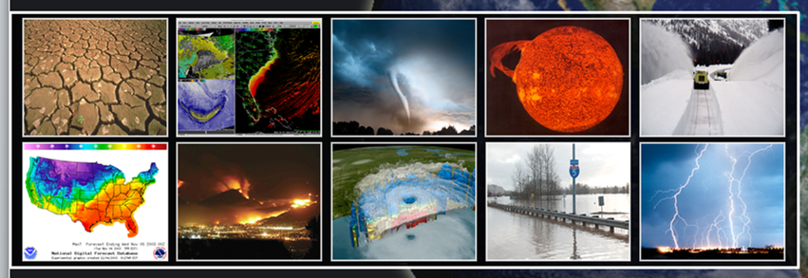
An overview on Mesoscale Convective Systems and their forward motion
National Weather Service
Brian Squitieri, Ph.D.
Storm Prediction Center

Slide 2
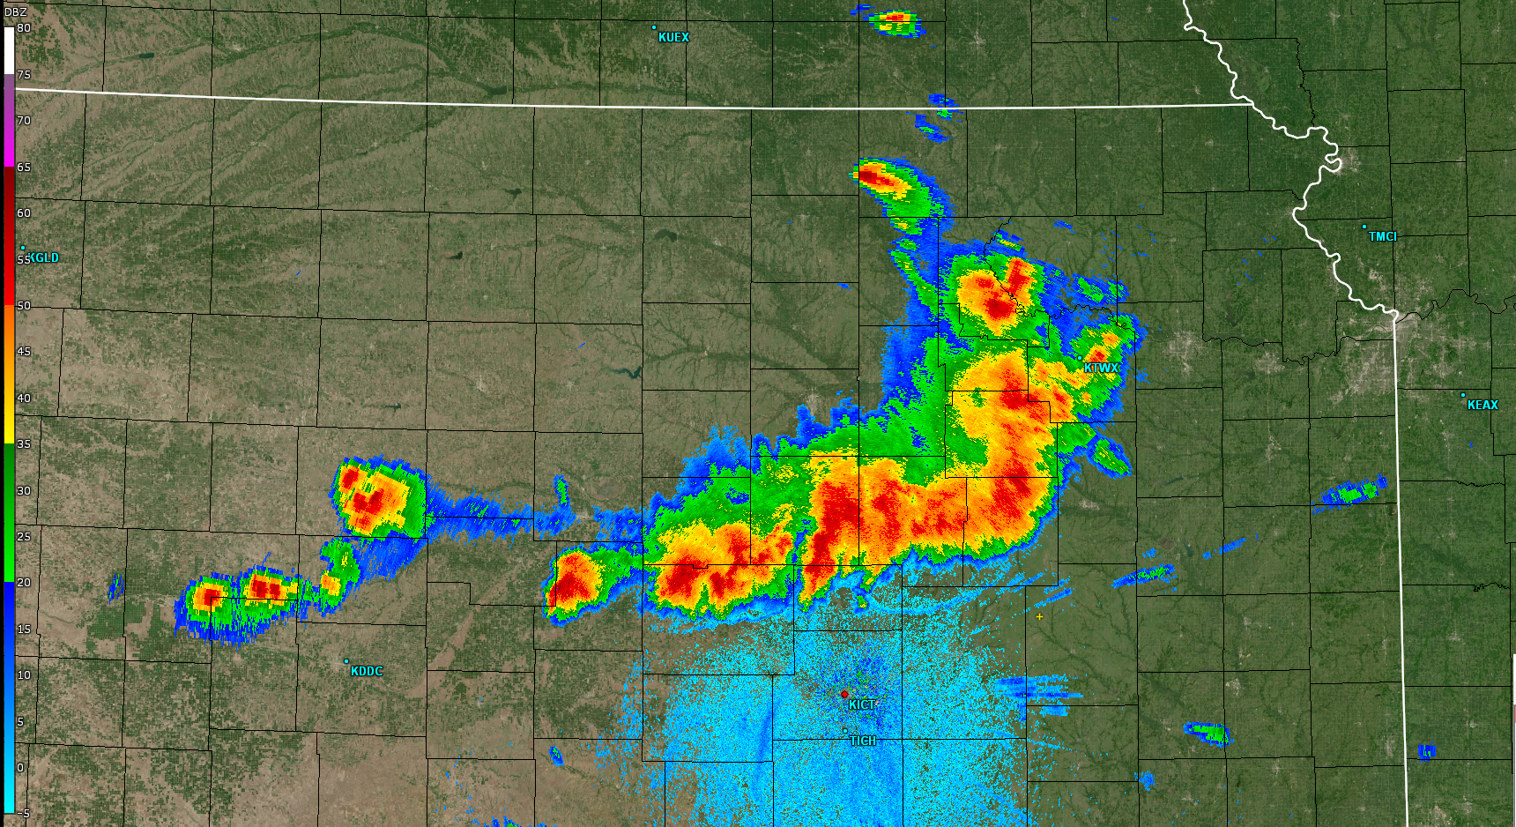
What is an MCS?
A Mesoscale Convective System (MCS) is “a cloud system that occurs in connection with an ensemble of thunderstorms and produces a contiguous precipitation area on the order of 100 km or more in horizontal scale in at least one direction” (AMS Glossary – 2025).
This definition can be applied liberally to any organized thunderstorm clusters that:
  Is at least 100 km long
  Lasts for at least 3 hours
  Shares a common feature, such as a trailing precipitation region or cold pool.
MCSs may take on many forms, morphology and evolution
MCSs may be accompanied by all thunderstorm hazards:
  Heavy rain and potential flooding
  Frequent Lightning
  Strong, damaging winds/gusts
  Tornadoes
  Hail

Slide 3
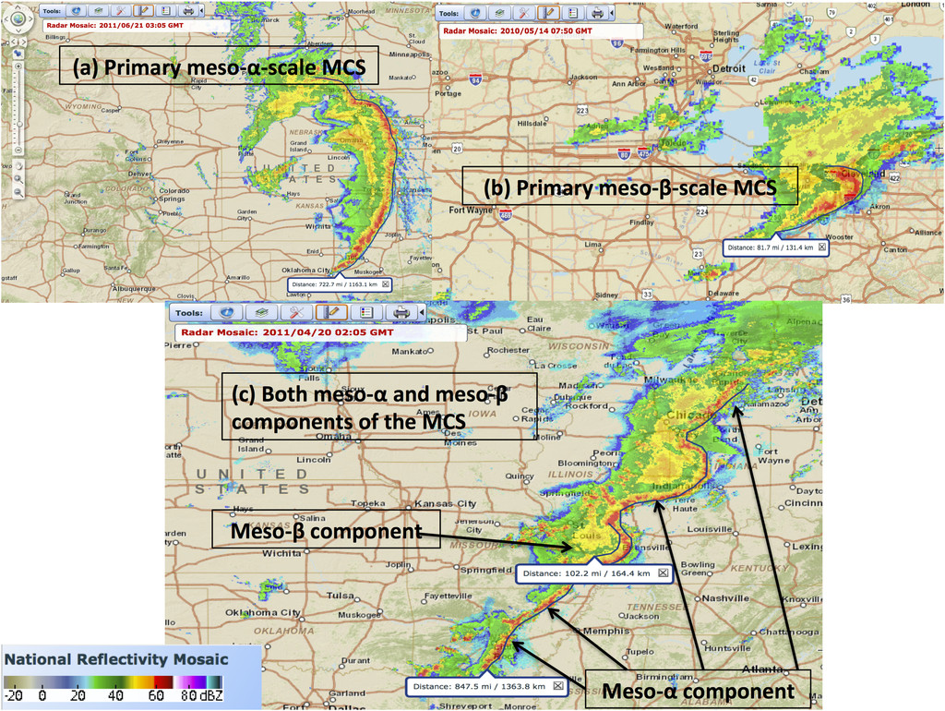
MCS Types
Campbell et al. (2017)

Slide 4
MCSs on the spatial and temporal spectrum

Slide 5
MCSs on the spatial and temporal spectrum
Parker and Johnson (2000): MCS defined as convective phenomenon where Coriolis acceleration is the same order of magnitude as all other terms in Navier-Stokes equations of motion.

Slide 6

MCSs on the spatial and temporal spectrum
Parker and Johnson (2000): MCS defined as convective phenomenon where Coriolis acceleration is the same order of magnitude as all other terms in Navier-Stokes equations of motion.

Slide 7
MCSs on the spatial and temporal spectrum
Parker and Johnson (2000): MCS defined as convective phenomenon where Coriolis acceleration is the same order of magnitude as all other terms in Navier-Stokes equations of motion.

Slide 8
MCSs on the spatial and temporal spectrum
Parker and Johnson (2000): MCS defined as convective phenomenon where Coriolis acceleration is the same order of magnitude as all other terms in Navier-Stokes equations of motion.
Markowski and Richardson (2010): Most Phenomena have space/time scale ratios on the same order of magnitude (10 m s⁻¹)

Slide 9
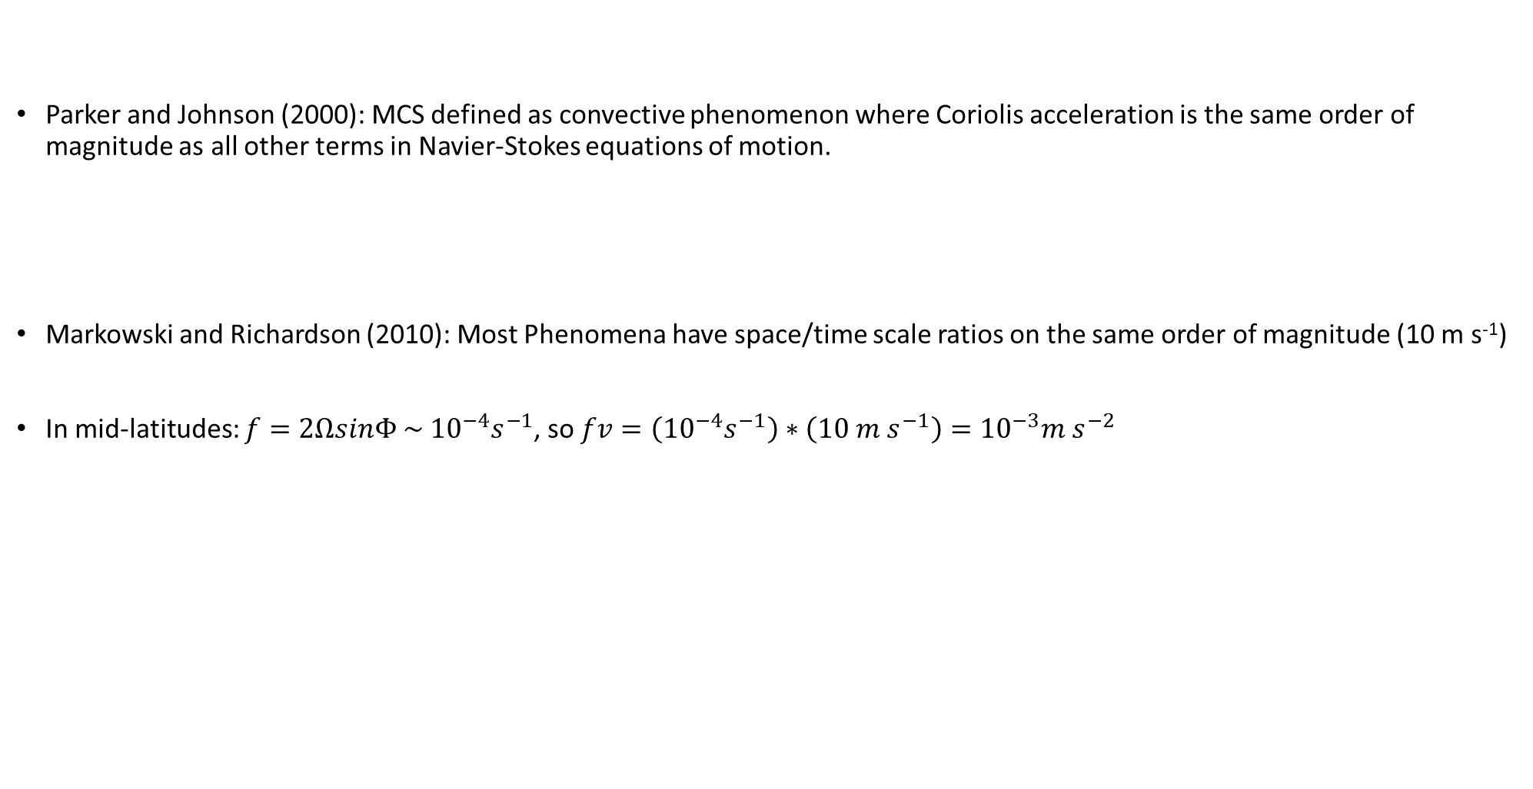
MCSs on the spatial and temporal spectrum

Slide 10
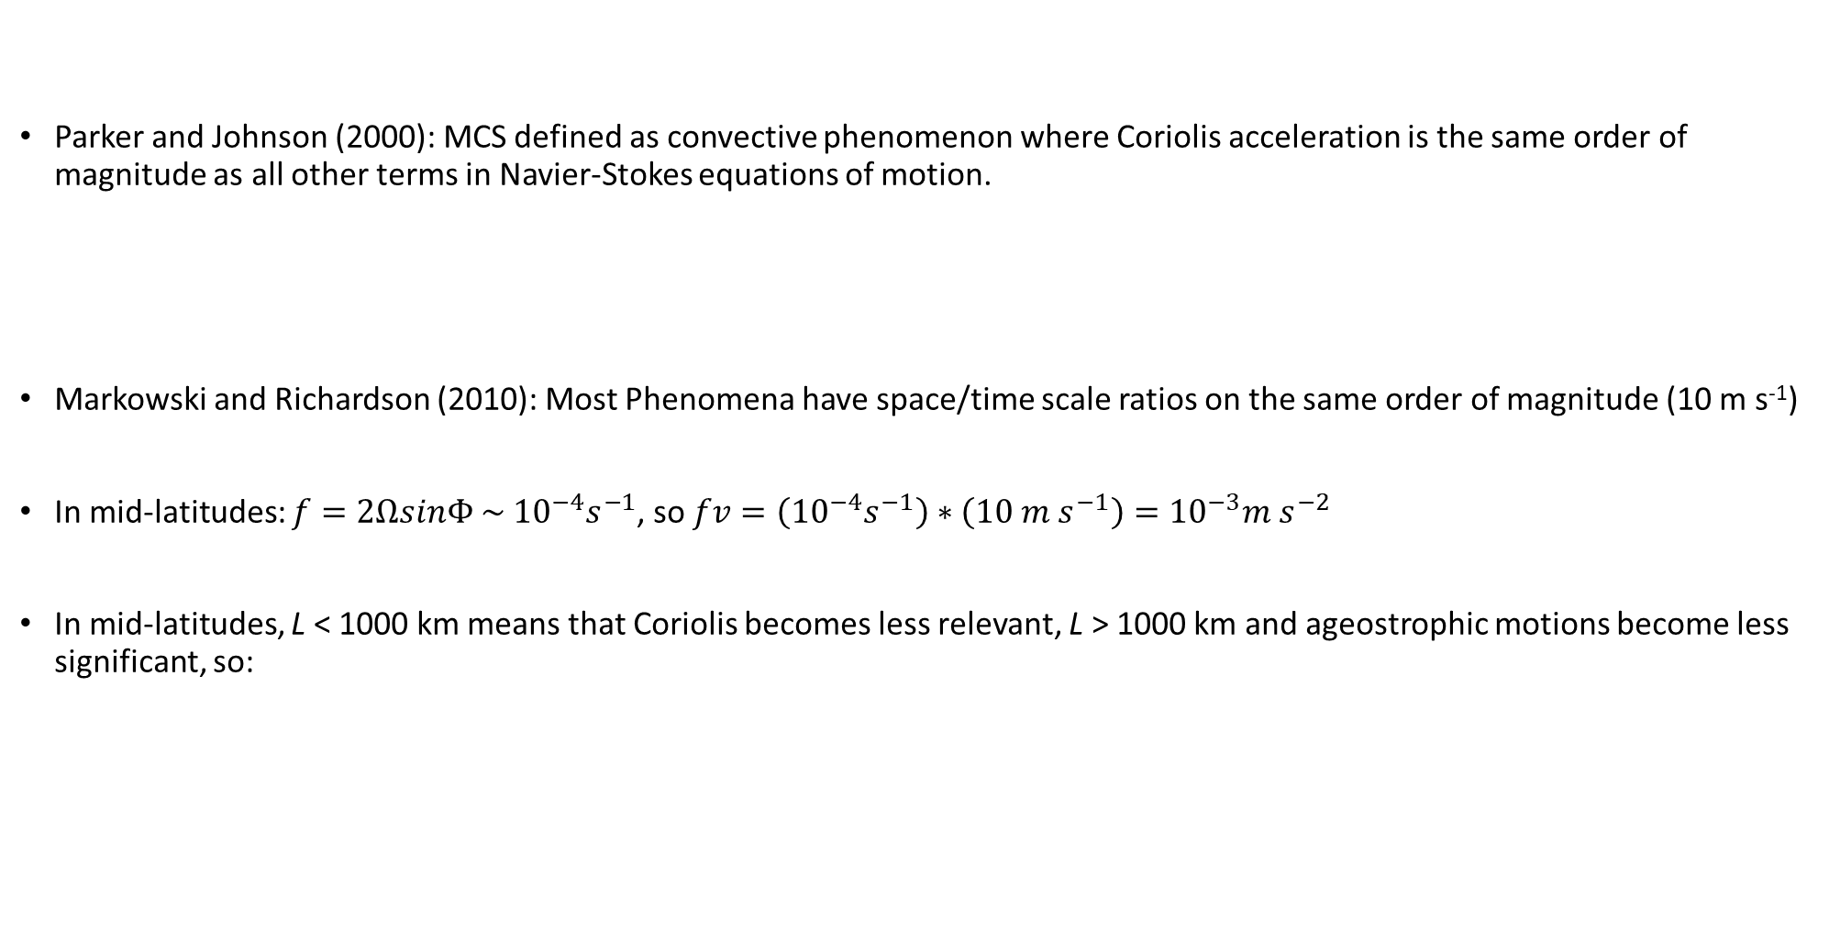
MCSs on the spatial and temporal spectrum

Slide 11
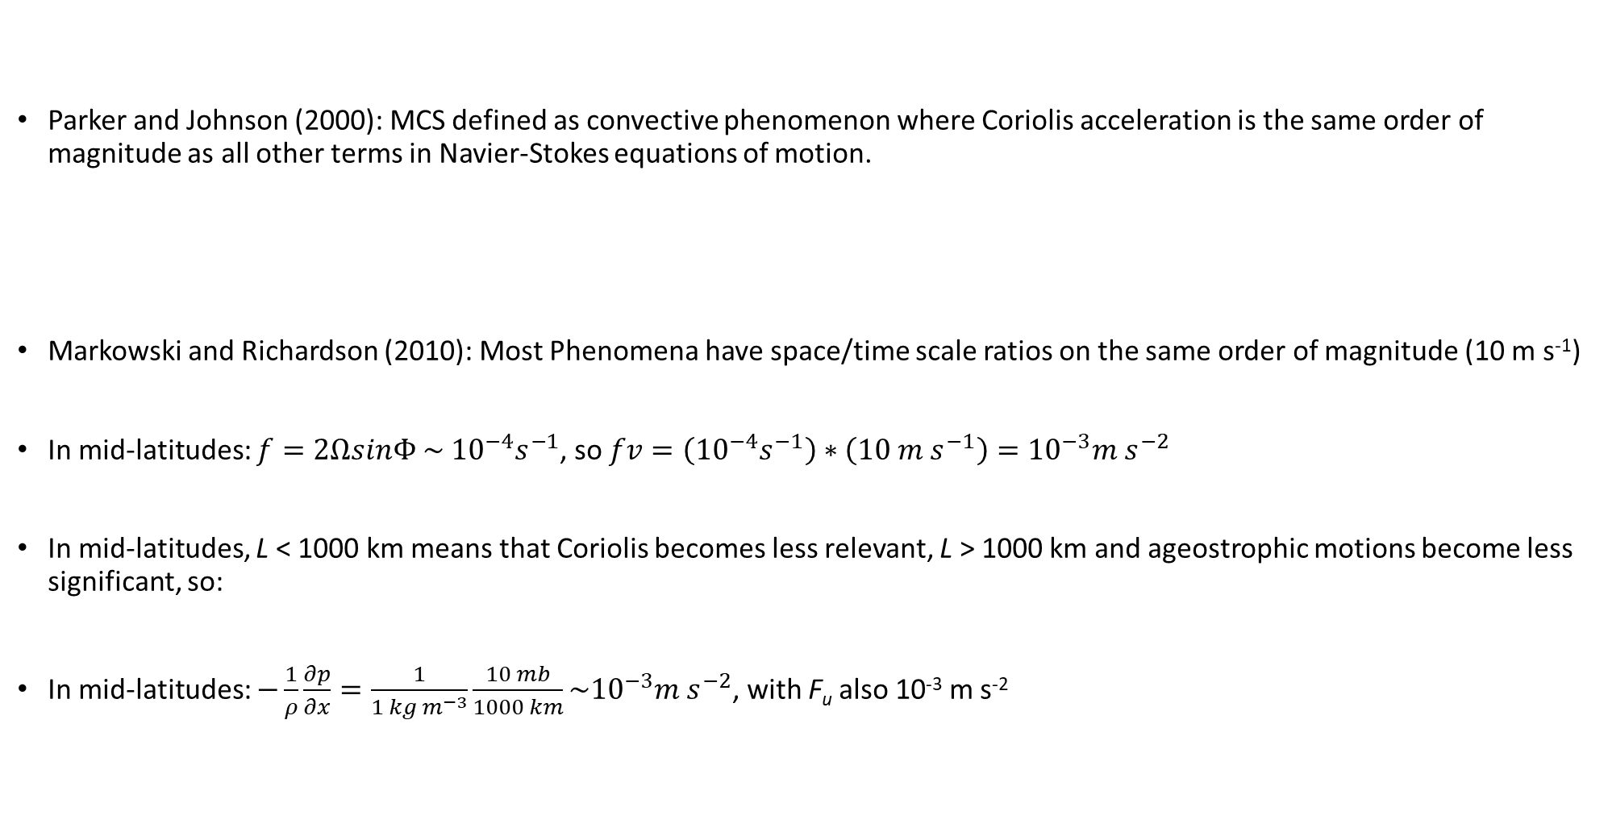
MCSs on the spatial and temporal spectrum

Slide 12
MCSs on the spatial and temporal spectrum
Parker and Johnson (2000): If Coriolis is equal to other forces in Navier-Stokes, then the timescale should be f⁻¹.

Slide 13
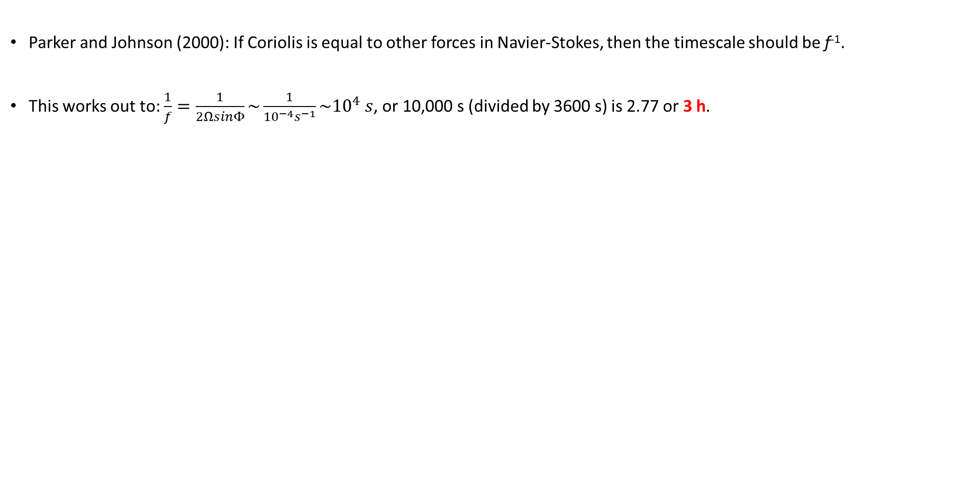
MCSs on the spatial and temporal spectrum

Slide 14
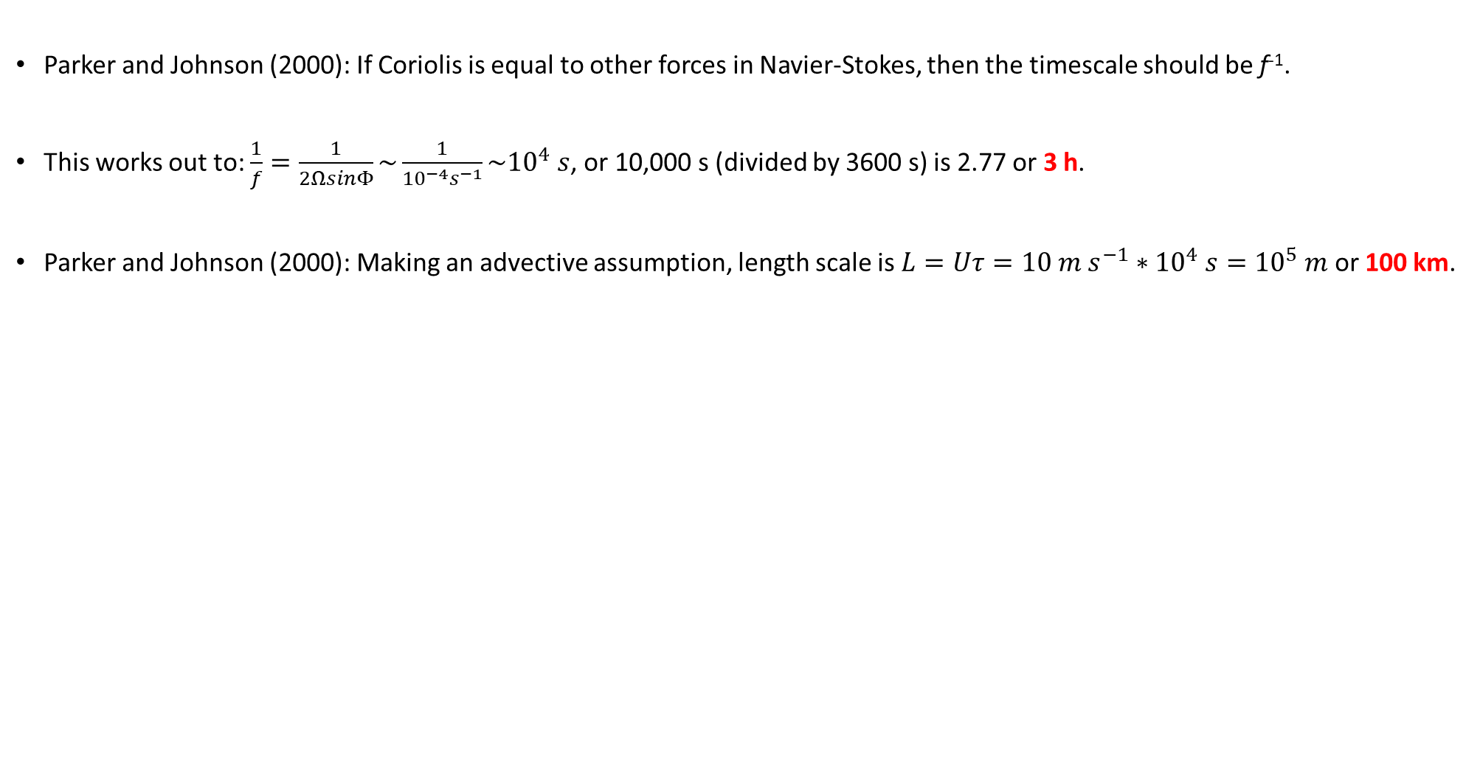
MCSs on the spatial and temporal spectrum

Slide 15
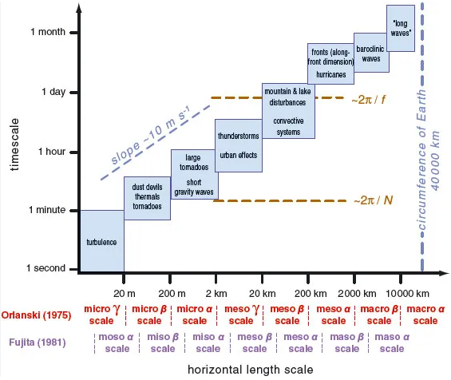

Slide 16
*Synoptic-scales allows for neglecting vertical accelerations and geostrophic wind advection, and micro-scale allows for Coriolis and horizontal pressure gradient forces to be neglected.

Slide 17
*Synoptic-scales allows for neglecting vertical accelerations and geostrophic wind advection, and micro-scale allows for Coriolis and horizontal pressure gradient forces to be neglected.
*Mesoscale doesn’t allow for these forces to be neglected, and Markowski and Richardson (2010) explicitly cite long-lived MCSs as an example where all forces need to be accounted for.

Slide 18
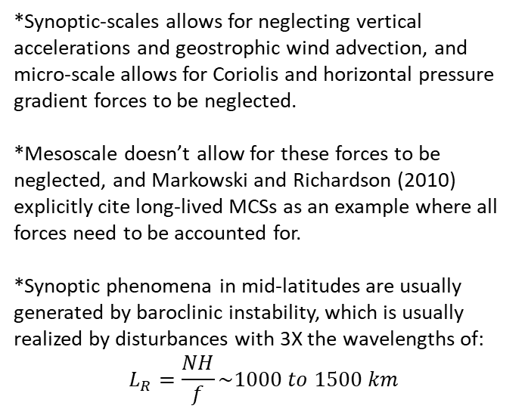

Slide 19
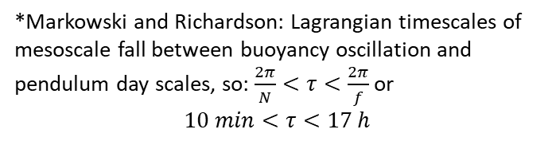
17 h
10 min

Slide 20
17 h
MCS scale
100 km, 3 h
10 min

Slide 21
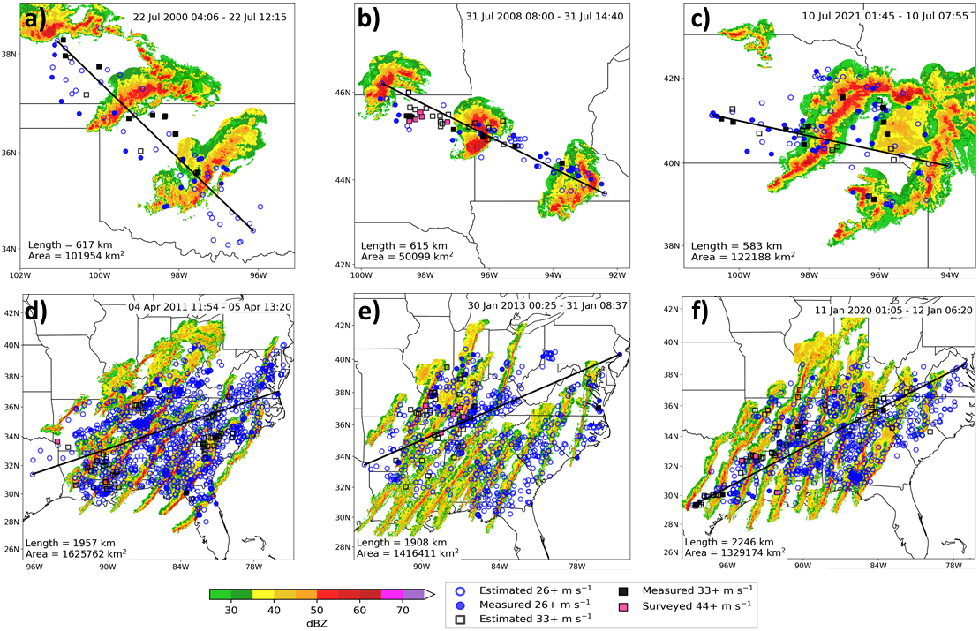
Cold-pool-driven MCSs tend to differ in structure from synoptically forced squall lines, with differences in wind swath attributes
8h 6h 6h
25h 32h 29h

Slide 22
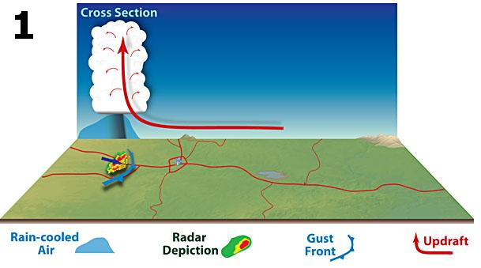

Slide 23
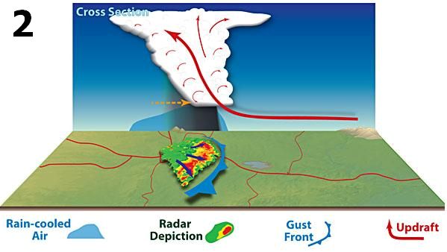

Slide 24
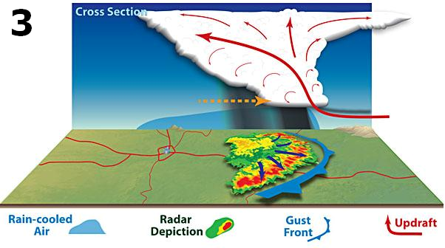
Forward Motion

Slide 25
Secondary Upper Circulation
Secondary Lower Circulation
Forward Motion
Trailing Precipitation Region
MCS Leading Line

Slide 26
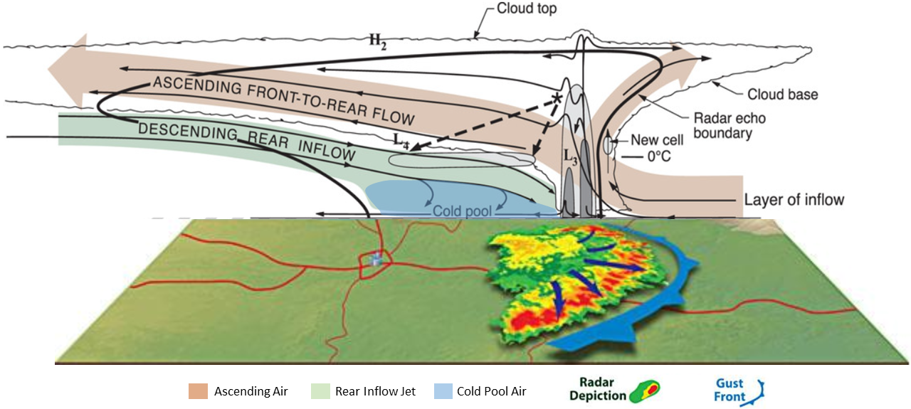

Slide 27
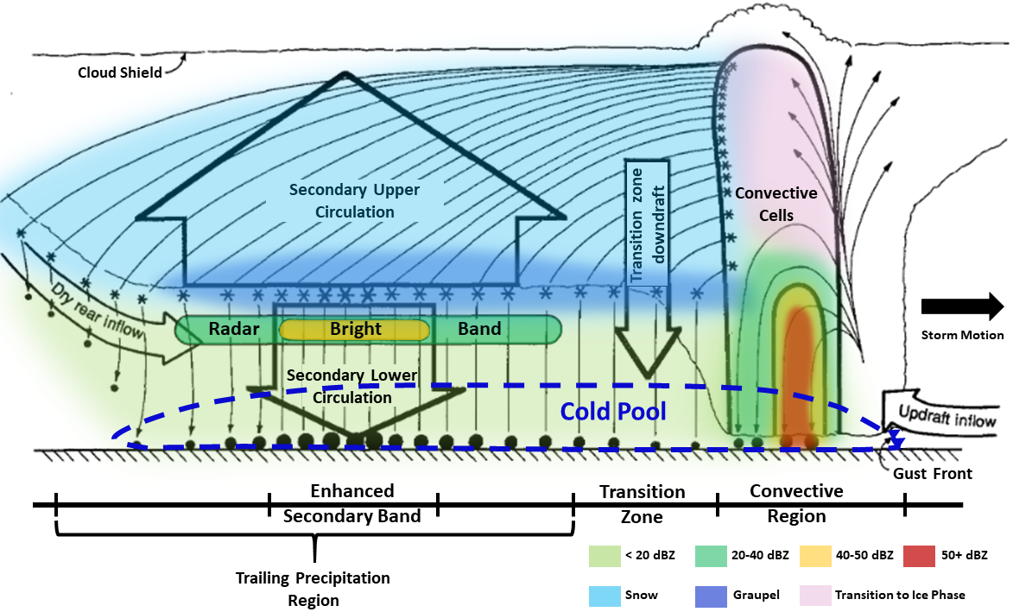

Slide 28
Let’s look here

Slide 29
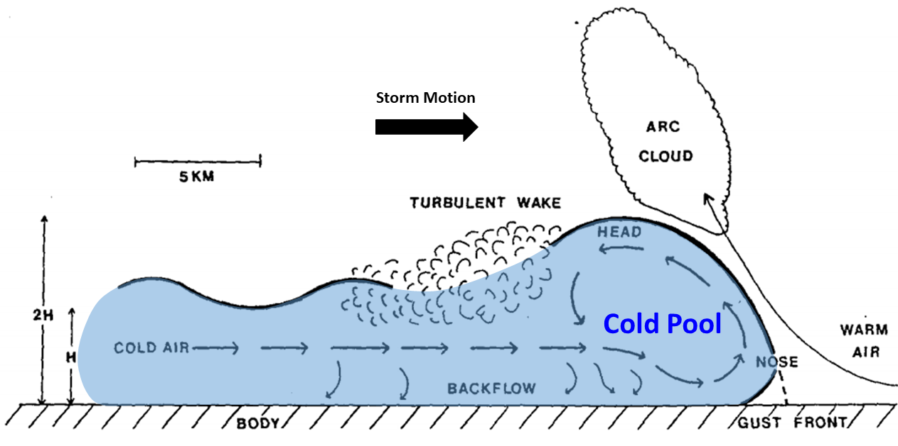

Slide 30
MCS Forward Motion
Johns and Hirt (1987) and Corfidi et al. (2016) both found that derechos move faster (sometimes much faster) than the full mean wind speed.
Derecho wind swaths are produced by thunderstorm clusters where either cold pool dynamics or other internal mechanisms dominate the processes that produce severe/destructive wind gusts.
Corfidi et al. (1996) and Corfidi (2003) devised a routine that can determine MCS forward motion based on the interaction between the cold pool and ambient flow fields.

Slide 31
MCS Forward Motion

Slide 32
MCS Forward Motion
MCS motion has 2 components (Advection and Propagation)

Slide 33
MCS Forward Motion
Advection:

Slide 34
MCS Forward Motion
Advection: Component of motion involving cells being carried with or by the mean wind in the cloud layer (V_{CL}).

Slide 35
MCS Forward Motion
Advection: Component of motion involving cells being carried with or by the mean wind in the cloud layer (V_{CL}).

Slide 36
MCS Forward Motion
Advection: Component of motion involving cells being carried with or by the mean wind in the cloud layer (V_{CL}).

Slide 37
MCS Forward Motion
Advection: Component of motion involving cells being carried with or by the mean wind in the cloud layer (V_{CL}).

Slide 38
MCS Forward Motion
Advection: Component of motion involving cells being carried with or by the mean wind in the cloud layer (V_{CL}).

Slide 39


MCS Forward Motion
Advection: Component of motion involving cells being carried with or by the mean wind in the cloud layer (V_{CL}).

Slide 40
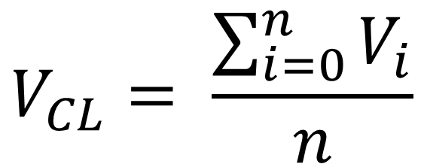
MCS Forward Motion
Advection: Component of motion involving cells being carried with or by the mean wind in the cloud layer (V_{CL}).

Slide 41
MCS Forward Motion
Advection: Component of motion involving cells being carried with or by the mean wind in the cloud layer (V_{CL}).
V_{CL}

Slide 42
MCS Forward Motion
MCS motion has 2 components (Advection and Propagation)

Slide 43
MCS Forward Motion
Propagation:

Slide 44
MCS Forward Motion
Propagation: Component of motion due to the initiation of new cells driven by the convergence of storm relative inflow (V_{Prop}).

Slide 45
MCS Forward Motion
Propagation: Component of motion due to the initiation of new cells driven by the convergence of storm relative inflow (V_{Prop}).
Cold Pool

Slide 46
MCS Forward Motion
Propagation: Component of motion due to the initiation of new cells driven by the convergence of storm relative inflow (V_{Prop}).
Cold Pool
LLJ

Slide 47
MCS Forward Motion
Propagation: Component of motion due to the initiation of new cells driven by the convergence of storm relative inflow (V_{Prop}).
Cold Pool
LLJ
Maximized
Convergence

Slide 48
MCS Forward Motion
Propagation: Component of motion due to the initiation of new cells driven by the convergence of storm relative inflow (V_{Prop}).
Cold Pool
LLJ
Maximized
Convergence

Slide 49
MCS Forward Motion
Propagation: Component of motion due to the initiation of new cells driven by the convergence of storm relative inflow (V_{Prop}).
Cold Pool
LLJ
Maximized
Convergence

Slide 50
MCS Forward Motion
Propagation: Component of motion due to the initiation of new cells driven by the convergence of storm relative inflow (V_{Prop}).
Cold Pool
LLJ
Maximized
Convergence

Slide 51
MCS Forward Motion
Propagation: Component of motion due to the initiation of new cells driven by the convergence of storm relative inflow (V_{Prop}).
Cold Pool
LLJ
Direction of Propagation
Maximized
Convergence

Slide 52
MCS Forward Motion
Propagation: Component of motion due to the initiation of new cells driven by the convergence of storm relative inflow (V_{Prop}).
Cold Pool
V_{-LLJ} = V_{Prop}
LLJ
Direction of Propagation
Maximized
Convergence

Slide 53
MCS Forward Motion
MCS motion has 2 components (Advection and Propagation)

Slide 54
MCS Forward Motion
MCS motion has 2 components (Advection and Propagation)
The Advection and Propagation components are both additive.

Slide 55
MCS Forward Motion
MCS motion has 2 components (Advection and Propagation)
The Advection and Propagation components are both additive.
V_{CL}

Slide 56
MCS Forward Motion
MCS motion has 2 components (Advection and Propagation)
The Advection and Propagation components are both additive.
V_{CL}
V_{Prop}

Slide 57
MCS Forward Motion
MCS motion has 2 components (Advection and Propagation)
The Advection and Propagation components are both additive.
V_{CL}
V_{Prop}
V_{MCS}

Slide 58
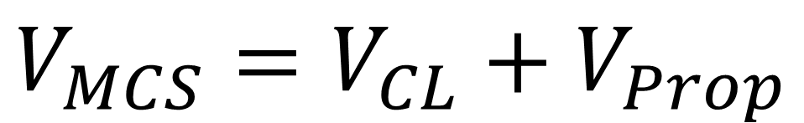
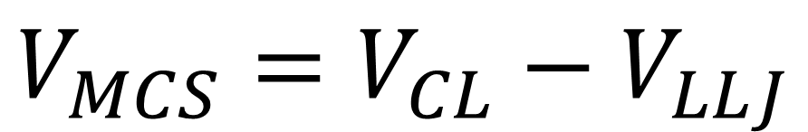
MCS Forward Motion
MCS motion has 2 components (Advection and Propagation)
The Advection and Propagation components are both additive.
V_{CL}
V_{Prop}
OR
V_{MCS}

Slide 59
V_{MCS} Magnitude and Direction

Slide 60
V_{MCS} Magnitude and Direction
V_{CL}
V_{Prop}
V_{MCS}

Slide 61


V_{MCS} Magnitude and Direction
V_{CL}
V_{Prop}
V_{MCS}

Slide 62
V_{MCS} Magnitude and Direction
We can find the speed and direction of the MCS motion vector using trigonometry.
V_{CL}
V_{Prop}
V_{MCS}

Slide 63
V_{MCS} Magnitude and Direction
We can find the speed and direction of the MCS motion vector using trigonometry.
However, these calculations are sensitive to the depth of the cloud layer of the mean wind, and the inflow layer available to the MCS, which can influence propagation.
V_{CL}
V_{Prop}
V_{MCS}

Slide 64
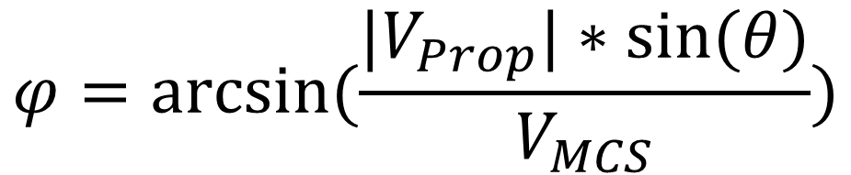
V_{MCS} Magnitude and Direction
We can find the speed and direction of the MCS motion vector using trigonometry.
However, these calculations are sensitive to the depth of the cloud layer of the mean wind, and the inflow layer available to the MCS, which can influence propagation.
V_{CL}
V_{Prop}
V_{MCS}

Slide 65
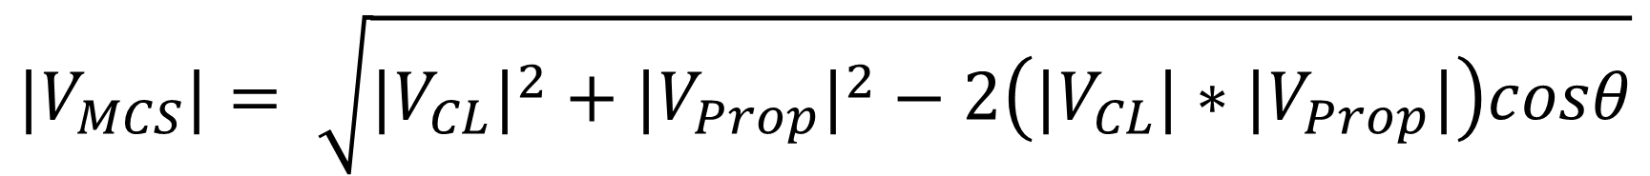
V_{MCS} Magnitude and Direction
We can find the speed and direction of the MCS motion vector using trigonometry.
However, these calculations are sensitive to the depth of the cloud layer of the mean wind, and the inflow layer available to the MCS, which can influence propagation.
V_{CL}
V_{Prop}
V_{MCS}

Slide 66
What happens when we increase LLJ wind speeds?

Slide 67
What happens when we increase LLJ wind speeds?
V_{CL} = 50 kts
θ = 50 degrees (0.87 radians)
V_{MCS}?
𝜑?

Slide 68
What happens when we increase LLJ wind speeds?
V_{CL} = 50 kts
θ = 50 degrees (0.87 radians)
V_{MCS}?
𝜑?
50 kts
50ᵒ
15 kts

Slide 69
What happens when we increase LLJ wind speeds?
V_{CL} = 50 kts
θ = 50 degrees (0.87 radians)
V_{MCS}?
𝜑?
50 kts
50ᵒ
50 kts
50ᵒ
15 kts
30 kts

Slide 70
What happens when we increase LLJ wind speeds?
V_{CL} = 50 kts
θ = 50 degrees (0.87 radians)
V_{MCS}?
𝜑?
50 kts
50ᵒ
50 kts
50ᵒ
50 kts
50ᵒ
15 kts
30 kts
45 kts

Slide 71
What happens when we increase LLJ wind speeds?
V_{CL} = 50 kts
θ = 50 degrees (0.87 radians)
V_{MCS}?
𝜑?
50 kts
50ᵒ
50 kts
50ᵒ
50 kts
50ᵒ
50 kts
15 kts
50ᵒ
30 kts
45 kts
60 kts

Slide 72
What happens when we increase LLJ wind speeds?
V_{CL} = 50 kts
θ = 50 degrees (0.87 radians)
V_{MCS}?
𝜑?
50 kts
50ᵒ
50 kts
50ᵒ
50 kts
50ᵒ
50 kts
15 kts
50ᵒ
30 kts
45 kts
16ᵒ
37ᵒ
60 kts
59ᵒ
42 kts
76ᵒ
38 kts
40 kts
47 kts

Slide 73
What happens when we decrease mean wind speeds?

Slide 74
What happens when we decrease mean wind speeds?
V_{PROP/LLJ} = 30 kts
θ = 50 degrees (0.87 radians)
V_{MCS}?
𝜑?

Slide 75
What happens when we decrease mean wind speeds?
V_{PROP/LLJ} = 30 kts
θ = 50 degrees (0.87 radians)
V_{MCS}?
𝜑?
50ᵒ
60 kts
30 kts

Slide 76
What happens when we decrease mean wind speeds?
V_{PROP/LLJ} = 30 kts
θ = 50 degrees (0.87 radians)
V_{MCS}?
𝜑?
50ᵒ
60 kts
30 kts
45 kts
50ᵒ
30 kts

Slide 77
What happens when we decrease mean wind speeds?
V_{PROP/LLJ} = 30 kts
θ = 50 degrees (0.87 radians)
V_{MCS}?
𝜑?
50ᵒ
60 kts
30 kts
45 kts
50ᵒ
30 kts
30 kts
50ᵒ
30 kts

Slide 78
What happens when we decrease mean wind speeds?
V_{PROP/LLJ} = 30 kts
θ = 50 degrees (0.87 radians)
V_{MCS}?
𝜑?
50ᵒ
60 kts
30 kts
45 kts
50ᵒ
30 kts
30 kts
50ᵒ
30 kts
15 kts
50ᵒ
30 kts

Slide 79
What happens when we decrease mean wind speeds?
V_{PROP/LLJ} = 30 kts
θ = 50 degrees (0.87 radians)
V_{MCS}?
𝜑?
50ᵒ
60 kts
30 kts
45 kts
50ᵒ
30 kts
30 kts
50ᵒ
30 kts
15 kts
29ᵒ
42ᵒ
50ᵒ
65ᵒ
30 kts
47 kts
34 kts
79ᵒ
25 kts
23 kts

Slide 80
MCS Forward Motion

Slide 81
MCS Forward Motion
Not a straightforward relationship. MCS can propagate both upwind and downwind of the mean vertical wind field.

Slide 82
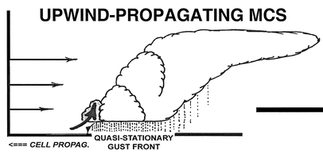
MCS Forward Motion
Not a straightforward relationship. MCS can propagate both upwind and downwind of the mean vertical wind field.
V_{Prop}

Slide 83
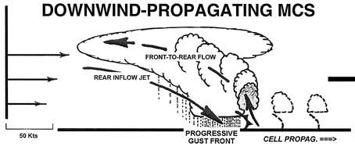
MCS Forward Motion
Not a straightforward relationship. MCS can propagate both upwind and downwind of the mean vertical wind field.
V_{Prop}
50 kts
V_{Prop}

Slide 84
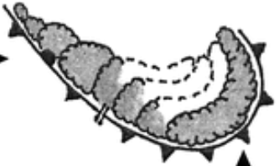
MCS Forward Motion
Not a straightforward relationship. MCS can propagate both upwind and downwind of the mean vertical wind field.
V_{Prop}
50 kts
V_{Prop}

Slide 85
MCS Forward Motion
Not a straightforward relationship. MCS can propagate both upwind and downwind of the mean vertical wind field.
V_{Prop-Upwind}
V_{Prop}
50 kts
V_{Prop}

Slide 86
MCS Forward Motion
Not a straightforward relationship. MCS can propagate both upwind and downwind of the mean vertical wind field.
Corfidi et al. (1996) demonstrated how to account for upwind propagation. What about downwind propagation?
V_{Prop-Upwind}
V_{Prop-Downwind}?
V_{Prop}
50 kts
V_{Prop}

Slide 87
MCS Forward Motion Factors

Slide 88
MCS Forward Motion Factors
The Corfidi et al. (1996) method only factors mean-wind and low-level wind/convergence-driven propagation influences.

Slide 89
MCS Forward Motion Factors
The Corfidi et al. (1996) method only factors mean-wind and low-level wind/convergence-driven propagation influences.
What about the cold pool? Studies have shown that MCS forward speed is dependent on cold pool evolution (Charba 1974; Newton and Fankhauser 1975; Betts 1976; Miller and Betts 1977).

Slide 90
MCS Forward Motion Factors
In reality, MCS forward motion is influenced by 3 factors: Mean Wind Speed - V_{CL}, Upwind (low-level-convergence-driven) propagation - V_{Prop-Upwind}, and Downwind (cold-pool-driven) propagation – V_{Prop-Downwind} (Corfidi 2003).
However, the Corfidi et al. (1996) V_{MCS} vector already takes into upwind propagation, so we can substitute this vector in as a component of MCS motion. Henceforth, we will call the ‘V_{MCS}’ vector ‘V_{upwind}’.

Slide 91
MCS Forward Motion Factors
Again, the components of MCS forward motion are additive, so we add V_{CL} and V_{upwind} to get V_{downwind}. As such,

Slide 92
MCS Forward Motion Factors
Again, the components of MCS forward motion are additive, so we add V_{CL} and V_{upwind} to get V_{downwind}. As such,
V_{CL}
V_{Prop}
V_{MCS}

Slide 93
MCS Forward Motion Factors
Again, the components of MCS forward motion are additive, so we add V_{CL} and V_{upwind} to get V_{downwind}. As such,
V_{CL}
V_{Prop}
becomes
V_{MCS}

Slide 94
MCS Forward Motion Factors
Again, the components of MCS forward motion are additive, so we add V_{CL} and V_{upwind} to get V_{downwind}. As such,
V_{Upwind}
V_{CL}
V_{CL}
V_{Prop}
becomes
V_{MCS}
Where V_{MCS} = V_{Upwind}

Slide 95
MCS Forward Motion Factors
Again, the components of MCS forward motion are additive, so we add V_{CL} and V_{upwind} to get V_{downwind}. As such,
V_{Upwind}
V_{CL}
V_{CL}
V_{Prop}
becomes
V_{Downwind}
V_{MCS}
Where V_{MCS} = V_{Upwind}

Slide 96
MCS Forward Motion Factors
Downwind-propagating MCSs are dominated by the cold pool, and derechos are also produced by cold-pool-driven MCSs, which are dominated by internal forcing mechanisms.
As such, V_{downwind} would be a useful vector for monitoring derecho progression.
Note that V_{downwind} is a longer vector than V_{CL}.
V_{Upwind}
V_{CL}
V_{Downwind}

Slide 97
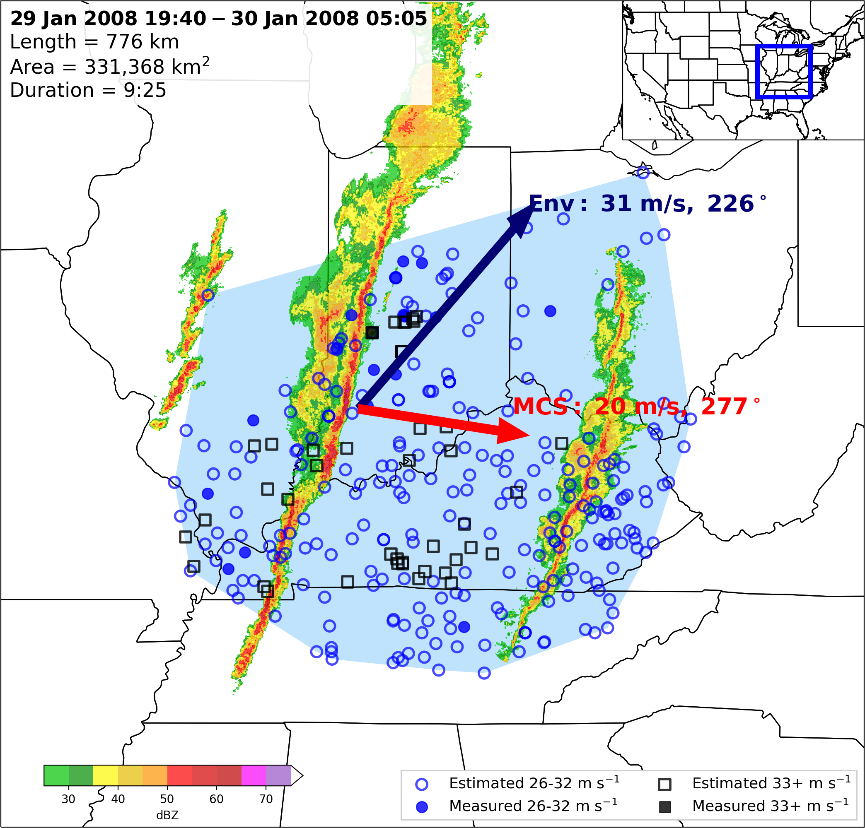
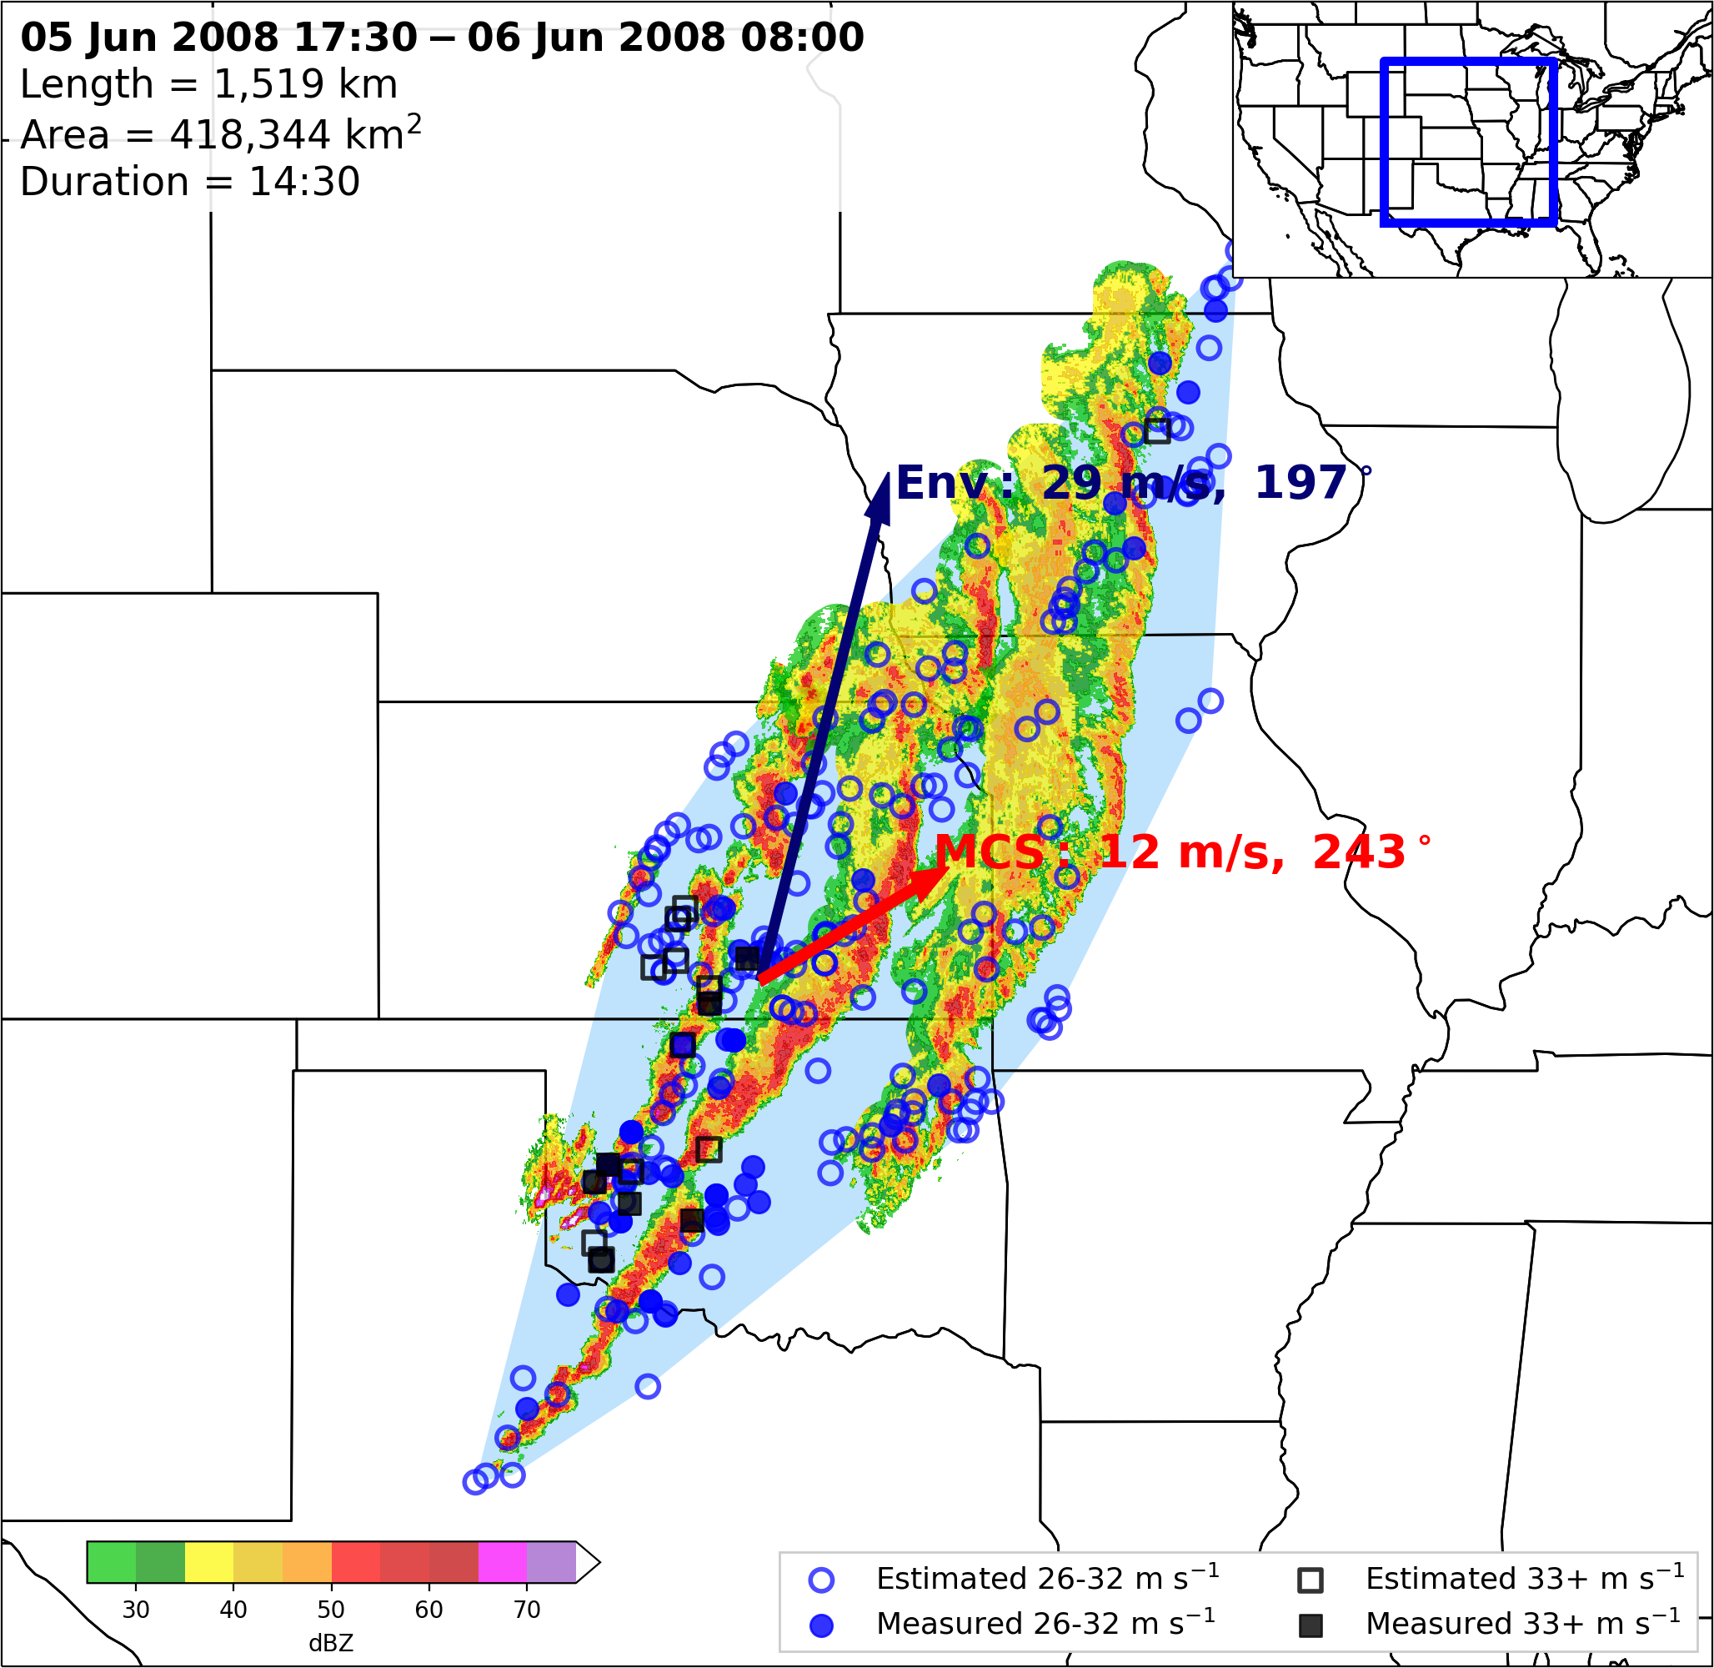
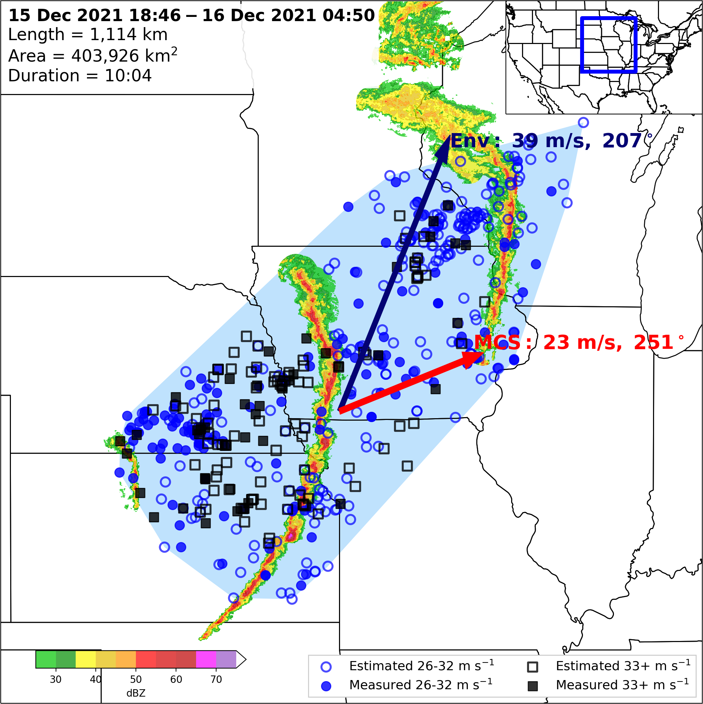
MCSs moving faster than the mean wind speed is an excellent discriminator between cold-pool-driven MCSs and their squall line counterparts.
Note: Cold-pool-driven MCSs and strongly forced squall lines both have degrees of internal and external forcing (i.e. a level of contribution from the cold pool
The argument is that to define derechos as a distinct phenomena, internal forcing mechanisms must dominate, which is defined by the MCS moving faster than the full mean wind speed.

Slide 98
References
Corfidi, S. F., 2003: Cold pools and MCS propagation: Forecasting the motion of downwind-developing MCSs. Wea. Forecasting, 18, 997–1017, https://doi.org/10.1175/1520-0434(2003)018<0997:CPAMPF>2.0.CO;2.
Corfidi, S. F., Merritt J. H. , and Fritsch J. M. , 1996: Predicting the movement of mesoscale convective complexes. Wea. Forecasting, 11 , 41–46. https://doi.org/10.1175/1520-0434(1996)011<0041:PTMOMC>2.0.CO;2.
Houze, R. A., 2018: 100 years of research on mesoscale convective systems. A Century of Progress in Atmospheric and Related Sciences: Celebrating the American Meteorological Society Centennial, Meteor. Monogr., No. 59, Amer. Meteor. Soc., https://doi.org/10.1175/AMSMONOGRAPHS-D-18-0001.1.
Parker, M. D., and R. H. Johnson, 2000: Organizational modes of midlatitude mesoscale convective systems. Mon. Wea. Rev., 128, 3413–3436, https://doi.org/10.1175/1520-0493(2001)129<3413:OMOMMC>2.0.CO;2.

